Slide 1

Project 2 Data Analysis of the iris data set Data Analysis Applications in Agricultural Sciences
Presented by: Joenilo II Esperas Paduhilao
June 7, 2024

Slide 2
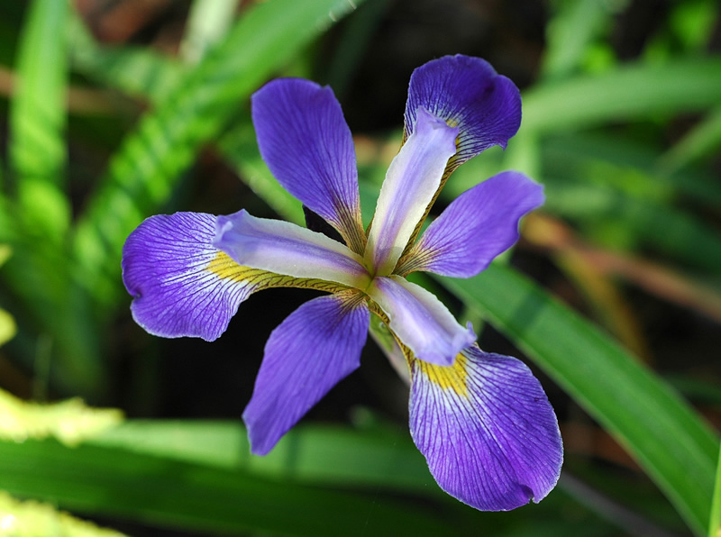
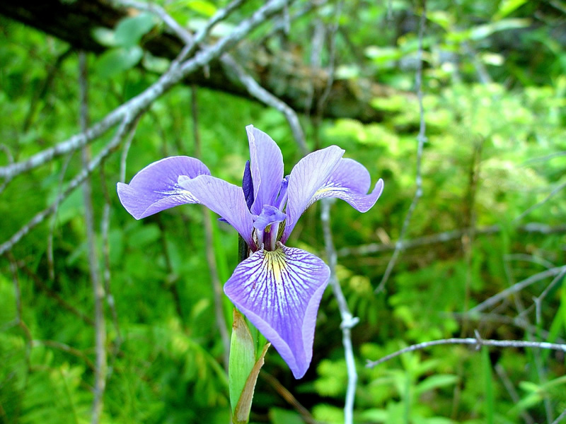
Introduction
Iris dataset collected by Edgar Anderson (1935) is commonly used for data exploration and analyses
Fisher, R. A. (1936) The use of multiple measurements in taxonomic problems. Annals of Eugenics, 7, Part II, 179–188
The case between Iris virginica and Iris versicolor
Analysis methods:
Measures of central tendencies and dispersion (Mean, variance, etc.)
Dimension reduction (PCA)
Machine Learning algorithms (ex. Random Forest)
Iris virginica
Objectives:
To identify features that distinguish Iris setosa, versicolor, and virginica;
To identify features with high importance in the iris dataset when training a model; and
To determine the model that can be trained fast and predict the test dataset most accurately.
Iris versicolor
Source: USDA Forest Service

Slide 3


Methods: Exploration and Visualization
Measures of central tendencies and dispersion & distribution
Packages
reshape2 v 1.4.4
ggplot2 v.3.5.1
gridExtra v2.3
IRIS Dataset
50 measurements of…
Iris setosa , Iris versicolor, and Iris virginica
Characteristics (centimeters)
Sepal Length
Sepal Width
Petal Length
Petal Width
Dimensionality reduction
Principal Component Analysis
stats::prcomp() stats/base v4.3.3
t-distributed Stochastic Neighbor Embedding
Rtsne v0.17

Slide 4
Methods: Packages used
Table 1. R packages used to analyze Edgar Anderson’s Iris Data. Description is based on the package description in R studio.
Package | Description | Purpose
reshape2 v1.4.4 | Flexibly Reshape Data: A Reboot of the Reshape Package | Modify iris data frame to merge plots
ggplot2 v3.5.1 | Create Elegant Data Visualisations Using the Grammar of Graphics | Plot Figures
gridExtra v2.3 | Miscellaneous Functions for “Grid” Graphics | Combine plots to one figure
factoextra v1.0.7 | Extract and Visualize the Results of Multivariate Data Analyses | Modify the labels in the PCA plot
stats /base v4.3.3 | The R Stats Package | PCA,
Rtsne v0.17 | T-Distributed Stochastic Neighbor Embedding using a Barnes-Hut Implementation | t-SNE

Slide 5
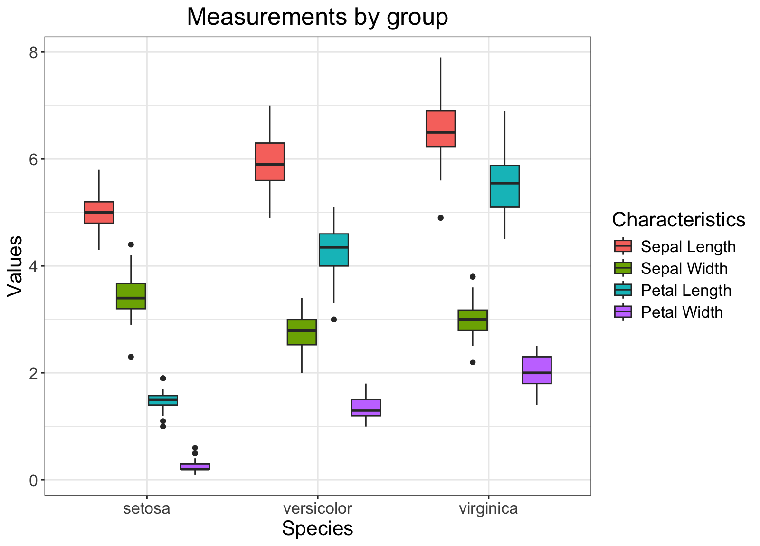
RESULTS
Sepal length and sepal width between species are indistinguishable
Sepal width and sepal width between versicolor and virginica have similar measures
Figure 1. Box plot of the four measurements (in cm) of the iris dataset.

Slide 6
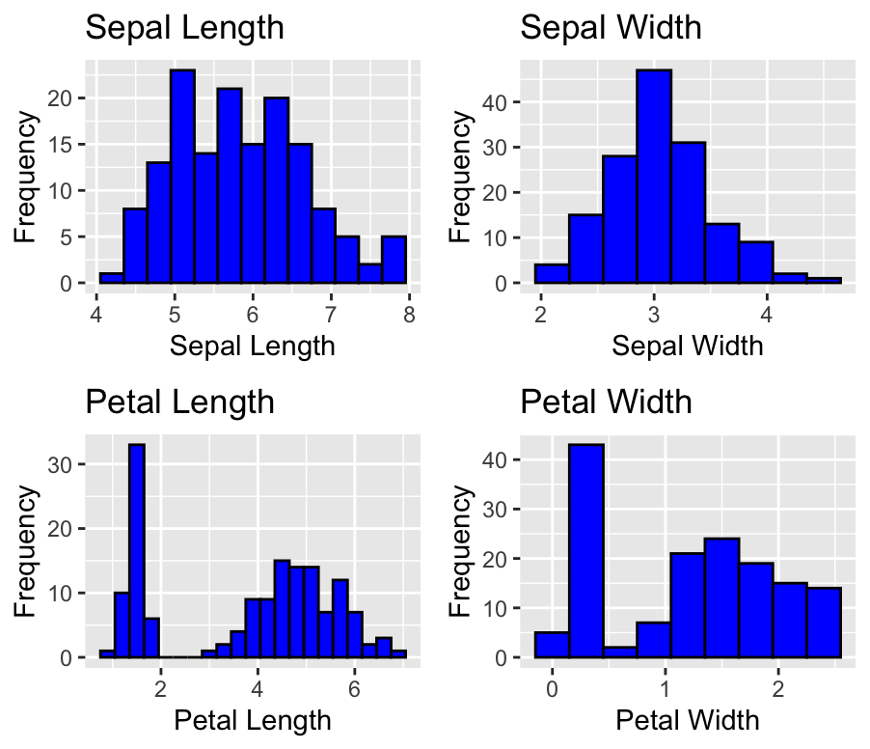
RESULTS
Extreme values may be attributed to the measures of Iris setosa, especially petal measurements
Figure 2. Histogram of the four measurements (in cm) of the iris dataset.

Slide 7
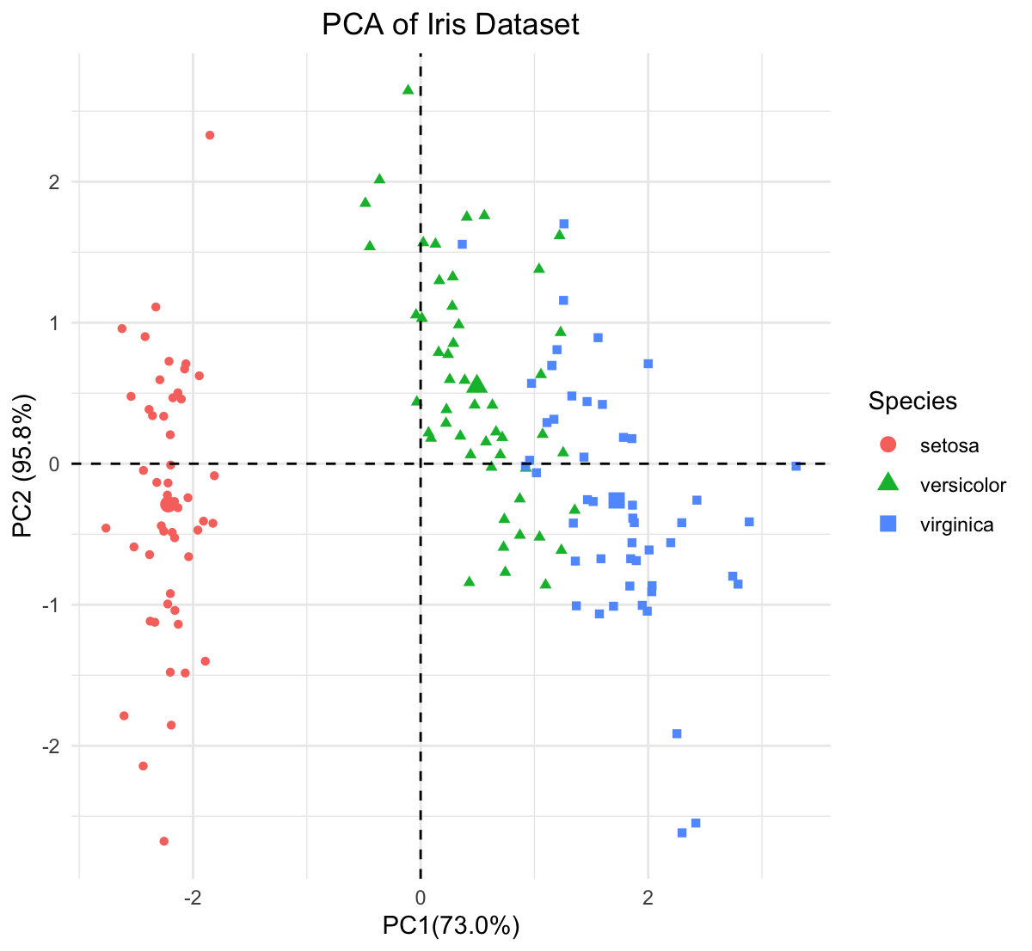
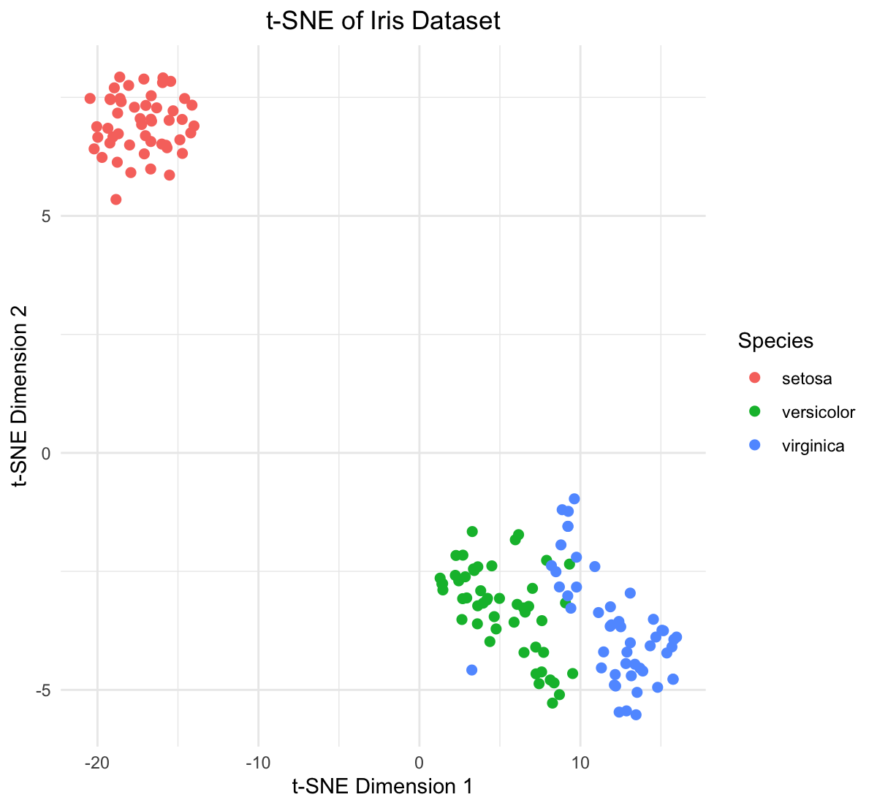
RESULTS
user: 0.000 system: 0.001 elapsed:0.007
linear | Large pairwise distances
user: 0.279 system: 0.001 elapsed:0.282
Non-linear | small pairwise distances
Figure 3. Dimensionality reduction of the iris dataset using (a) Principal Component Analysis and (b) t-distributed stochastic neighbor embedding. Run time was measured using system.time() function in R-base.

Slide 8


Methods: Learning
IRIS Dataset
PREPROCESS
Randomization df.sample(random_state=42)
Train and Test sets [] 80 – 20%
Standardization sklearn::StandardScalar()
Machine Learning Algorithms
Support Vector Machine M: sklearn.svm
Random Forest
M: sklearn.ensemble
Nearest Neighbors Classification M: sklearn.neighbors
Logistic Regression
M: sklearn.linear_model
Cross Validation sklearn.model_selection:: cross_val_score
Feature Importance sklearn.ensemble
Confusion Matrix sklearn.metric:: confusion_matrix
Validation Curve sklearn.model_selection:: learning_curve
Feature Engineering
Hyper Parameter Tuning sklearn.model_selection::GridSearch
Final Accuracy sklearn.metrics::accuracy_score

Slide 9
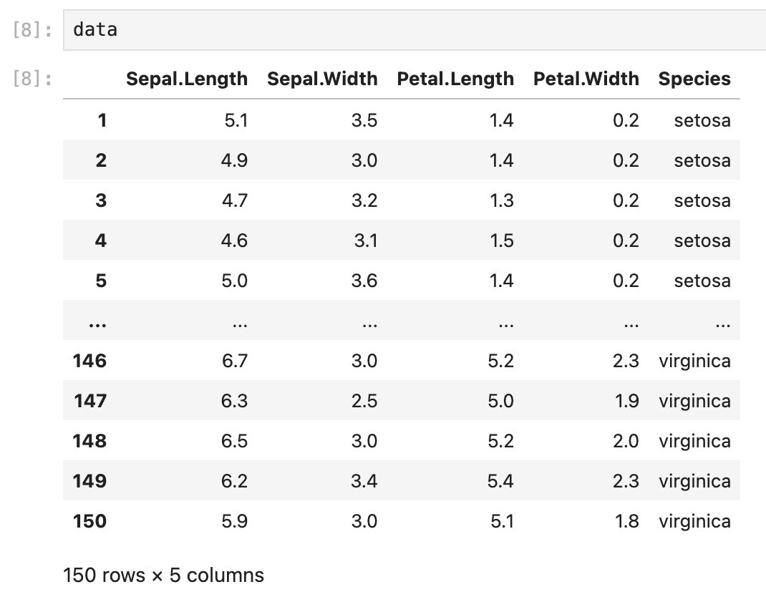
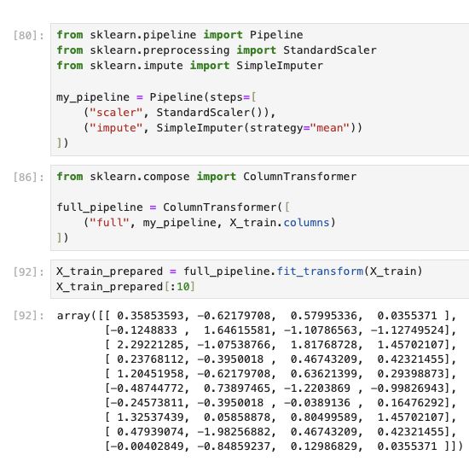
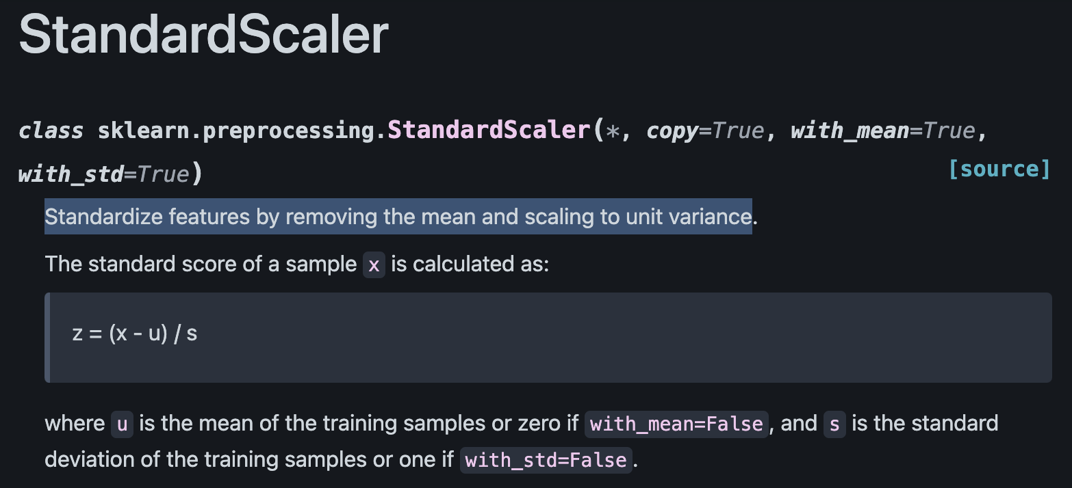
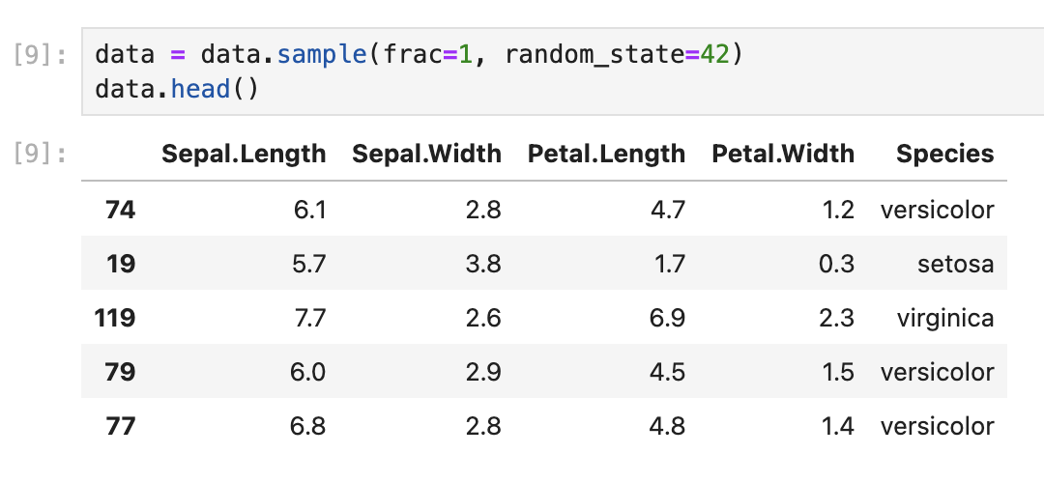
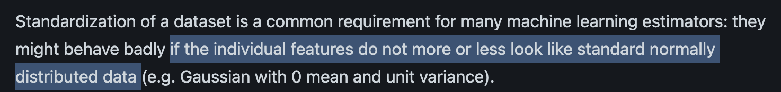
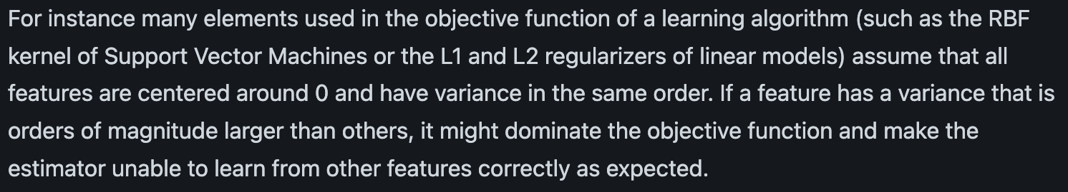
RESULTS:PREPROCESSING
Reasons to use StandardScaler
https://scikit-learn.org/stable/modules/generated/sklearn.preprocessing.StandardScaler.html

Slide 10
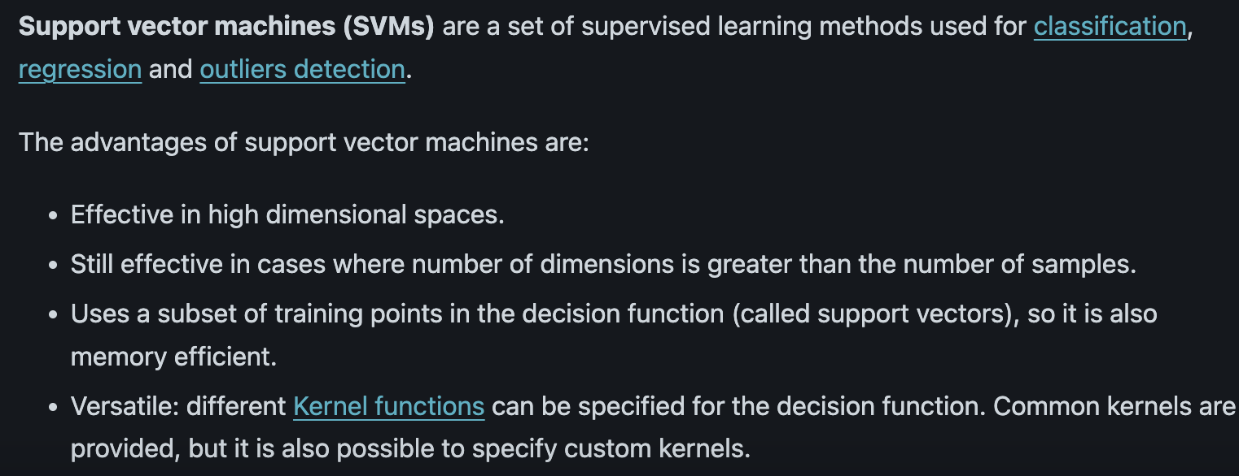
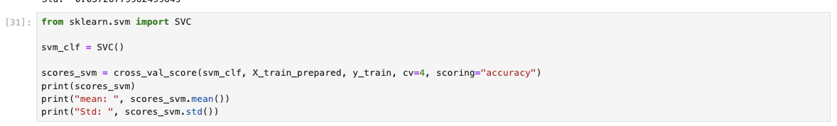
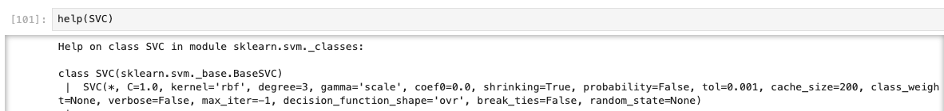
RESULTS:SVM supervised | optimal hyperplane and separate classes
CV (K-fold Cross Validation Process) | Value
1 | 1.0
2 | 0.97
3 | 0.93
4 | 0.93
MEAN | 0.96
Standard Deviation | 0.03
CPU times: user 9.09 ms, sys: 13.5 ms, total: 22.6 ms Wall time: 35.8 ms
Default
https://scikit-learn.org/stable/modules/svm.html

Slide 11
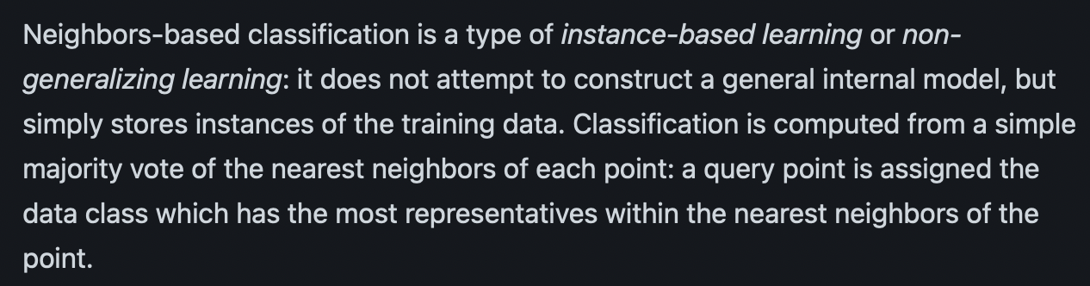
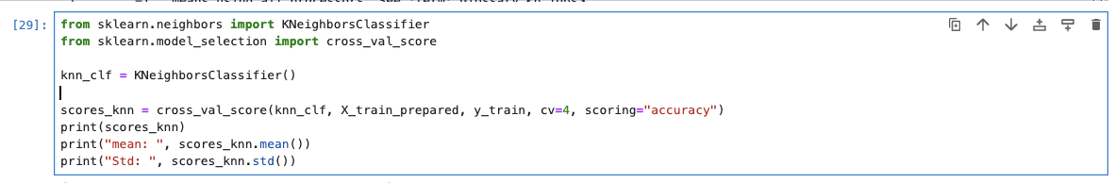
RESULTS:KNN (default n=5) instance-based | find knn and assign majority class
CV (K-fold Cross Validation Process) | Value
1 | 1.0
2 | 0.96
3 | 0.93
4 | 0.90
MEAN | 0.95
Standard Deviation | 0.04
CPU times: user 13.7 ms, sys: 12.6 ms, total: 26.3 ms Wall time: 42 ms
https://scikit-learn.org/stable/modules/generated/sklearn.neighbors.KNeighborsClassifier.html

Slide 12
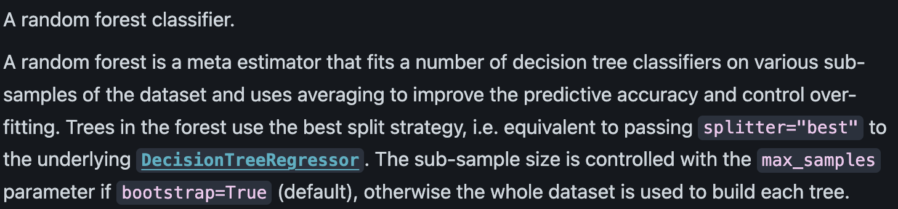
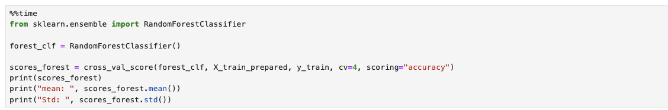
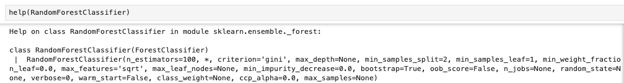
RESULTS: RandomForest Ensemble learning method | Multiple Decision Trees -> Combine
CV (K-fold Cross Validation Process) | Value
1 | 1.0
2 | 0.97
3 | 0.90
4 | 0.93
MEAN | 0.95
Standard Deviation | 0.04
CPU times: user 283 ms, sys: 15.6 ms, total: 299 ms Wall time: 310 ms
Default
https://scikit-learn.org/stable/modules/generated/sklearn.ensemble.RandomForestClassifier.html

Slide 13
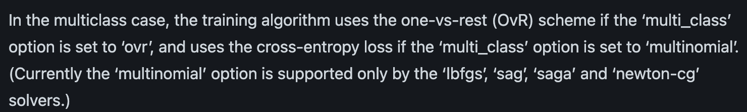
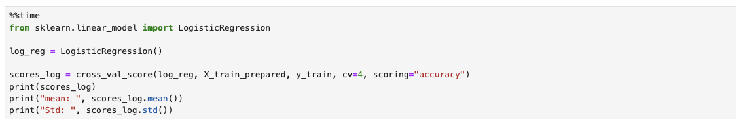
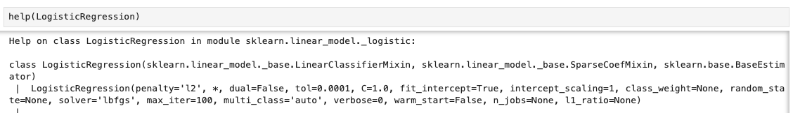
RESULTS: Logistic Regression Linear model | Sigmoid function –> P()
CV (K-fold Cross Validation Process) | Value
1 | 1.0
2 | 0.97
3 | 0.90
4 | 0.97
MEAN | 0.97
Standard Deviation | 0.02
CPU times: user 17.7 ms, sys: 13.8 ms, total: 31.5 ms Wall time: 38.9 ms
Default
https://scikit-learn.org/stable/modules/generated/sklearn.linear_model.LogisticRegression.html

Slide 14
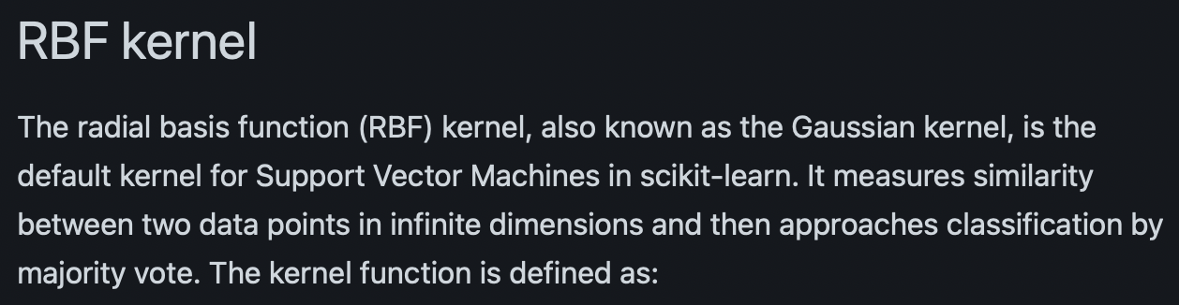
RESULTS: Learning Models
Table 2. Summary of the four algorithm in terms of modeling accuracies and time on the iris dataset.
In terms of mean accuracy, logistic regression is better than the other three models
In terms of time, SVM is the fastest while Random Forest is the slowest
CV (K-fold Cross Validation Process) | SVM | KNN | Random Forest | Logistic Regression
1 | 1.0 | 1.0 | 1.0 | 1.0
2 | 0.97 | 0.96 | 0.97 | 0.97
3 | 0.93 | 0.93 | 0.90 | 0.90
4 | 0.93 | 0.90 | 0.93 | 0.97
MEAN | 0.96 | 0.95 | 0.95 | 0.97
Standard Deviation | 0.03 | 0.04 | 0.04 | 0.02
Wall time | 35.8 ms | 42 ms | 310 ms | 38.9 ms
Test dataset Prediction | 0.90 | 0.90 | 0.90 | 0.93
Due to ~120-150 samples, the O(n²) complexity of SVM training does not result in a long computation time.
https://scikit-learn.org/stable/auto_examples/svm/plot_svm_kernels.html#sphx-glr-auto-examples-svm-plot-svm-kernels-py
Notes:
"O" stands for "Order of". It describes the worst-case scenario or the upper bound of the algorithm's time complexity."n" typically represents the size of the input, such as the number of data points in a dataset.O(n^2) means that the time complexity grows quadratically with the input size.

Slide 15
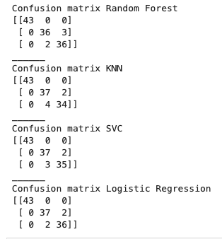
RESULTS: Confusion Matrix
Format
Combined Prediction Error Locations
 | Setosa | Versicolor | virginica
setosa
versicolor
virginica
(b)
Index | Sepal.Length | Sepal.Width | Petal.Length | Petal.Width | Species
134 | 6.3 | 2.8 | 5.1 | 1.5 | virginica
139 | 6.0 | 3.0 | 4.8 | 1.8 | virginica
78 | 6.7 | 3.0 | 5.0 | 1.7 | versicolor
71 | 5.9 | 3.2 | 4.8 | 1.8 | versicolor
84 | 6.0 | 2.7 | 5.1 | 1.6 | versicolor
135 | 6.1 | 2.6 | 5.6 | 1.4 | virginica
120 | 6.0 | 2.2 | 5.0 | 1.5 | virginica
73 | 6.3 | 2.5 | 4.9 | 1.5 | versicolor
(a)
All models have prediction errors on virginica and versicolor
Figure 4. (a) Confusion matrix and (b) error locations of the different models on iris dataset.

Slide 16
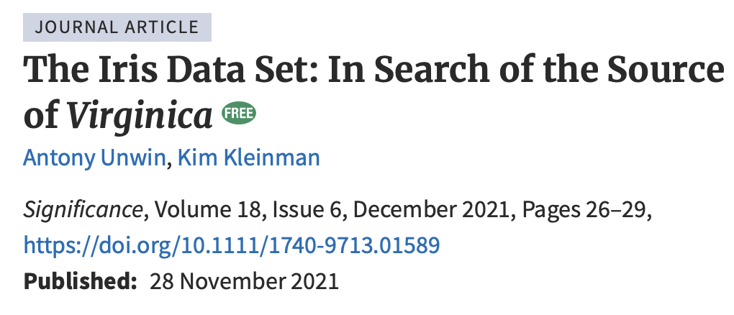
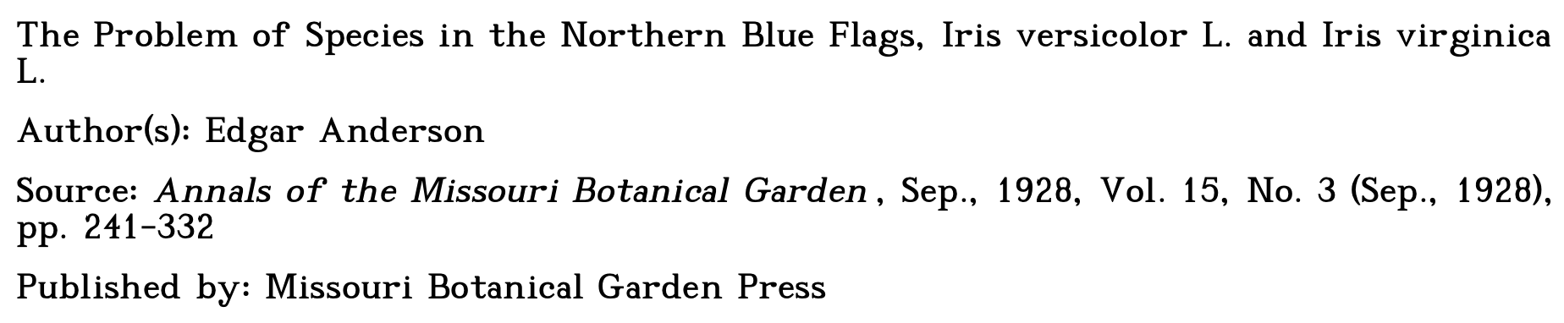
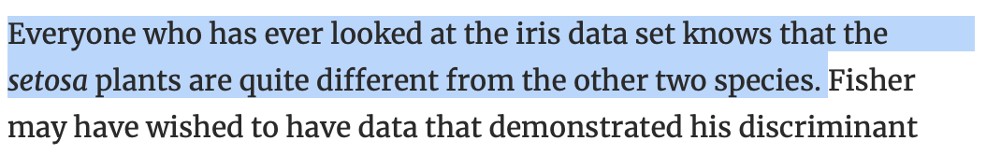
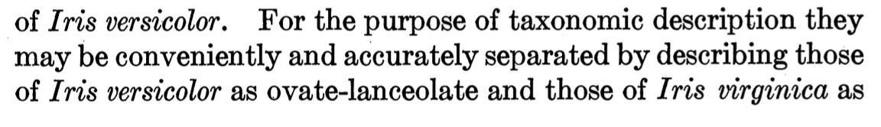
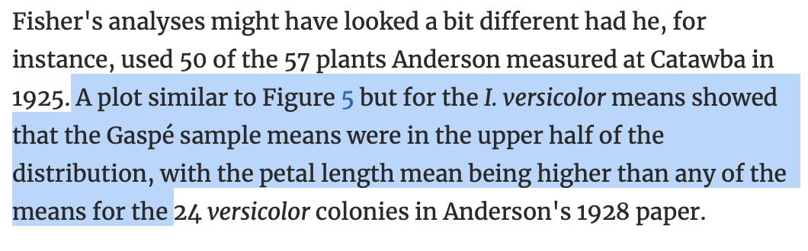
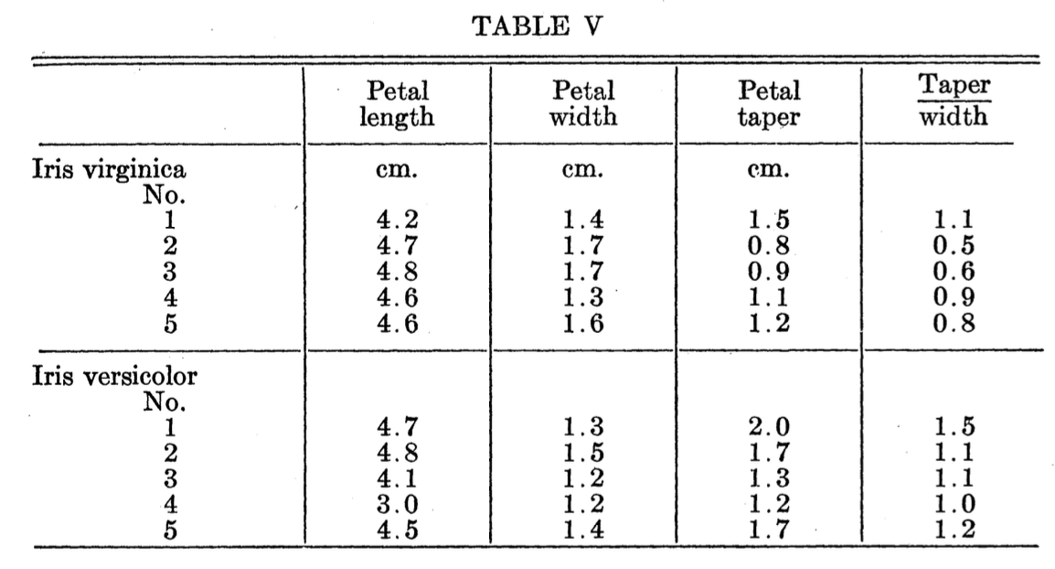
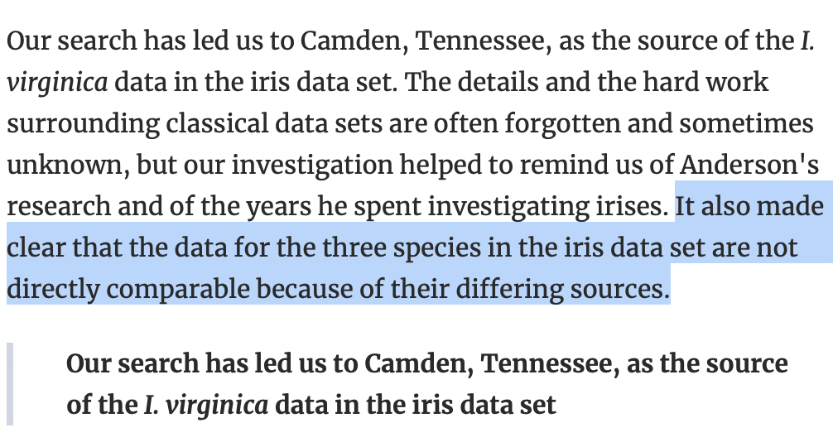
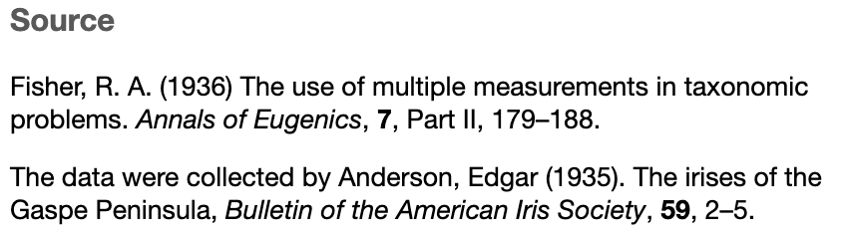
Referring to petals

Slide 17
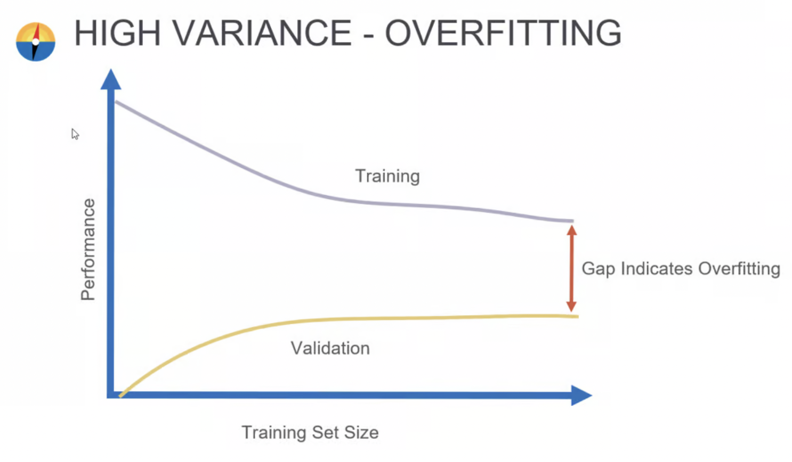
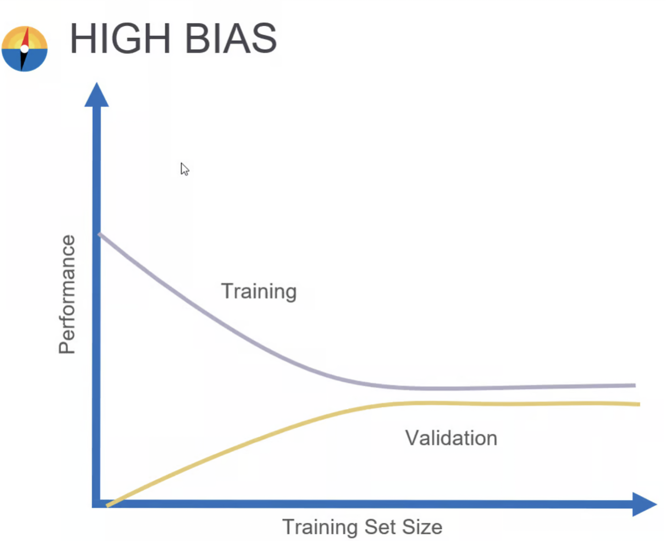
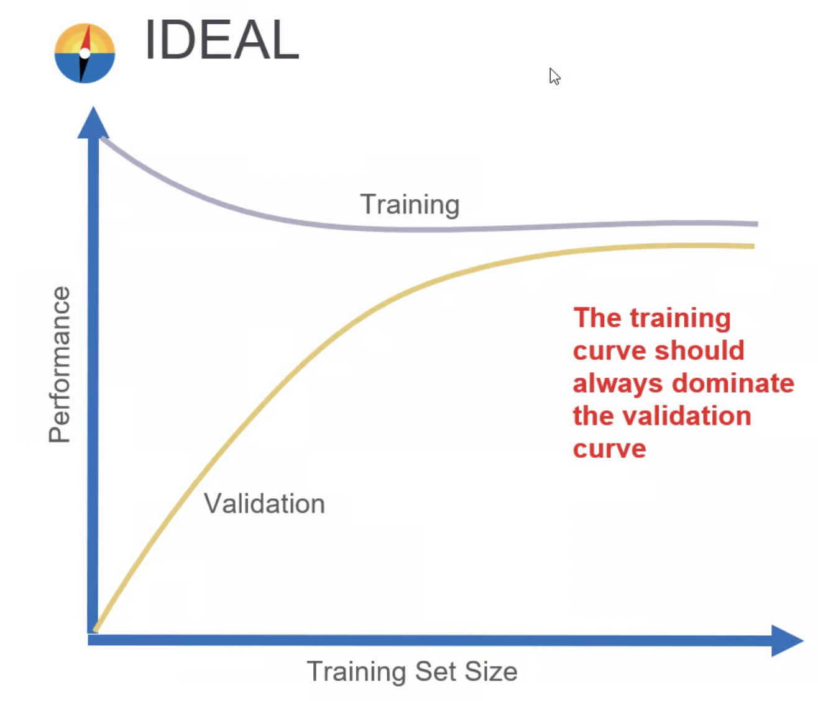
RESULTS: Overfitting/Underfitting Cases
Less variance and higher training accuracy
It performs well on the training data but generalizes poorly to unseen data
It fails to learn from the training data effectively
Possible cases of learning curves
https://codingnomads.com/validation-learning-curve-overfitting-and-underfitting
Notes:
The performance is low. This indicates high bias or a lack of complexity in the model. The model isn't finding the pattern in the data, and more data isn't helping.

Slide 18
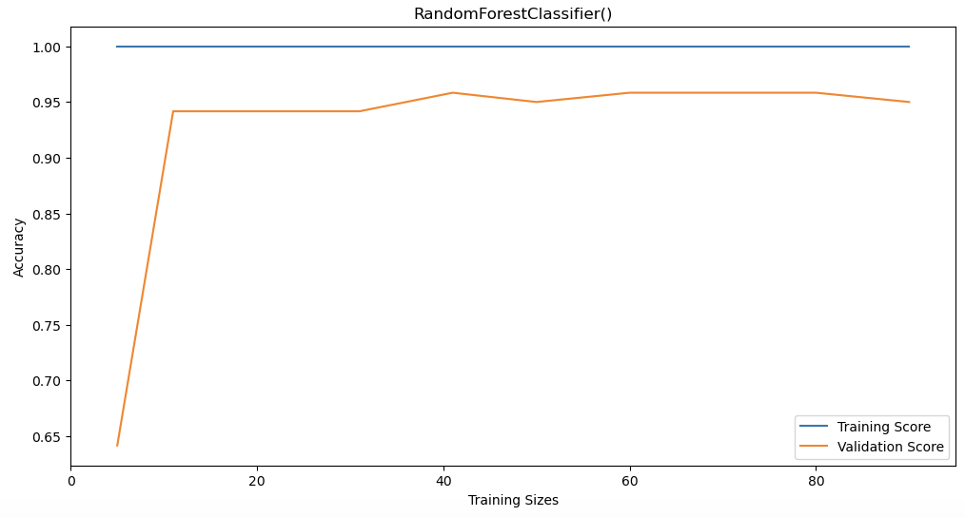
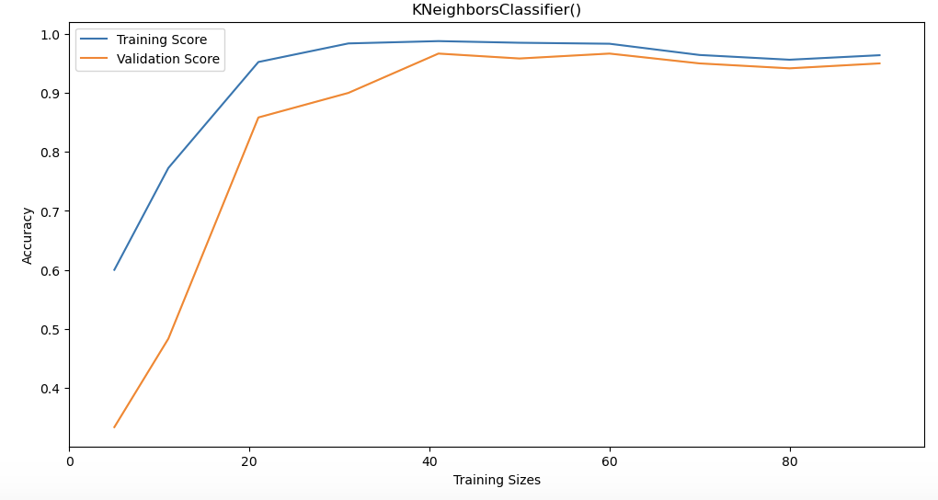
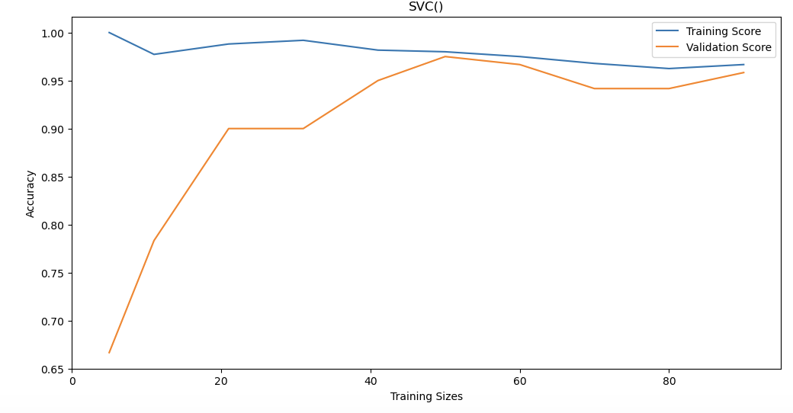
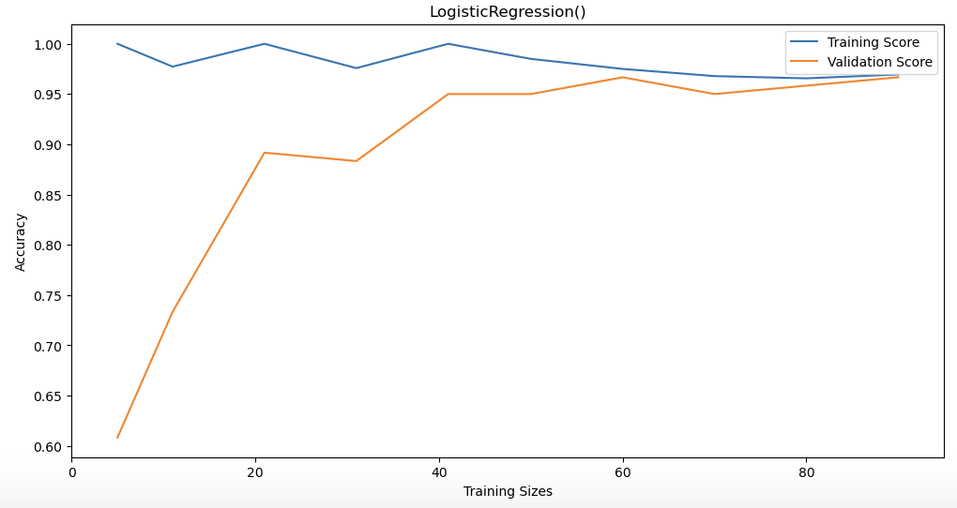
RESULTS: Overfitting/Underfitting Cases
Figure 5. Learning Curves of the four different models.
Notes:
This gap between training and validation accuracy is rather big, which means that the model has high variance. In conclusion, we can say that the Random Forest model overfits.

Slide 19
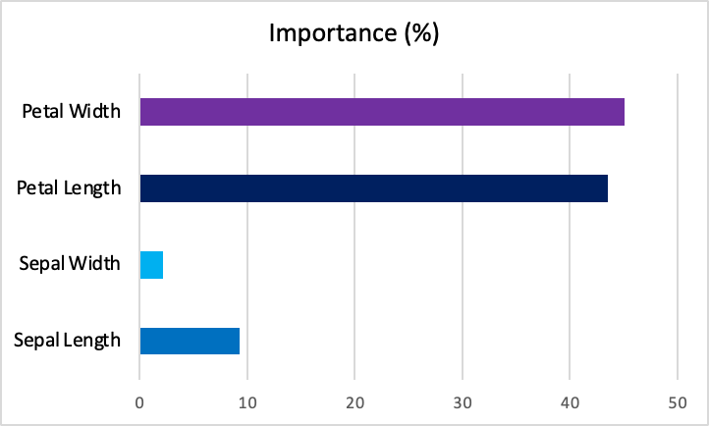
RESULTS: FEATURE ENGINEERING
Recall Fig.1
Figure 6. Feature Importance based on Random Forest Classification

Slide 20
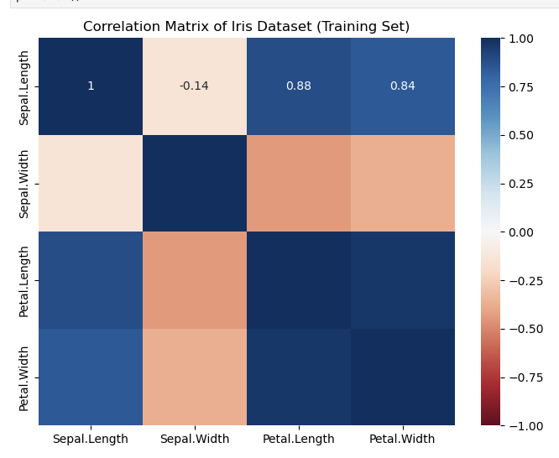
RESULTS: FEATURE ENGINEERING
Figure 6. Feature Importance based on Random Forest Classification
Figure 7. Correlation Matrix of the four characteristics of Iris.
Sepal length is correlated to petal length and width

Slide 21
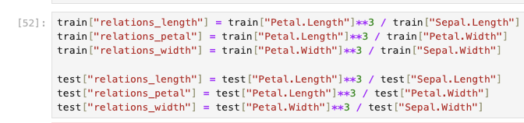


RESULTS: FEATURE ENGINEERING
Figure 7. Correlation Matrix of the four characteristics of Iris.
Figure 6. Feature Importance based on Random Forest Classification
Add Features

Slide 22
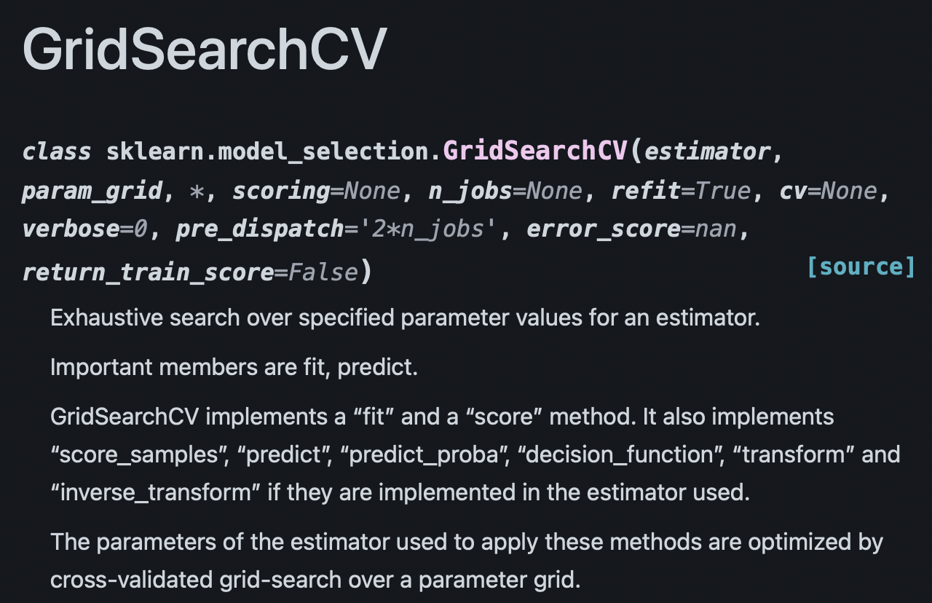
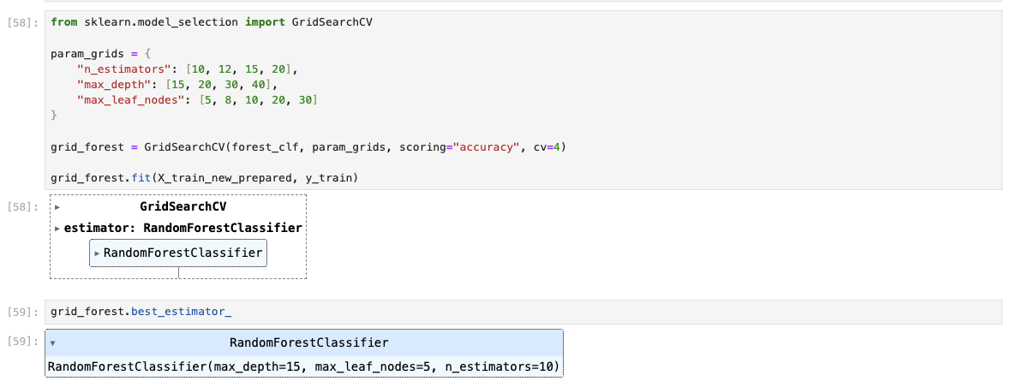
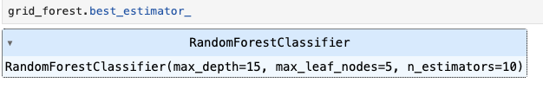
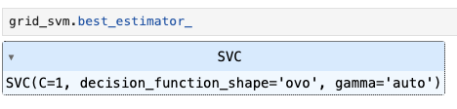
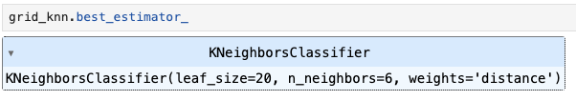
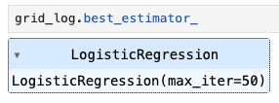
RESULTS: HYPERPARAMETER TUNING
Example of GridSearchCV utilization
Best estimators for each algorithm
https://scikit-learn.org/stable/modules/generated/sklearn.model_selection.GridSearchCV.html

Slide 23
RESULTS: OPTIMIZATION
Table 3. Cross Validation Scores after Optimization (Feature Engineering + Hyperparameter tuning)
Table 4. Prediction Accuracies based on the test datasets
Model | Before | After
Random Forest | 0.95 | 0.96
KNN | 0.95 | 0.98
SVC | 0.96 | 0.98
Logistic Regression | 0.97 | 0.98
Model | First Prediction | Second Prediction
Random Forest | 0.90 | 0.97
KNN | 0.90 | 0.97
SVC | 0.90 | 0.97
Logistic Regression | 0.93 | 1.0

Slide 24
CONCLUSION
Features of virginica and versicolor are almost indistinguishable, especially Sepal length and sepal width, while setosa is the easiest to determine;
SVM is the fastest among all the models to train while Random Forest is the slowest ;
Petal length and petal width are of highest feature importance;
Logistic Regression model predicted the test dataset perfectly (100%) after feature engineering and hyperparameter tuning

